Slide 1


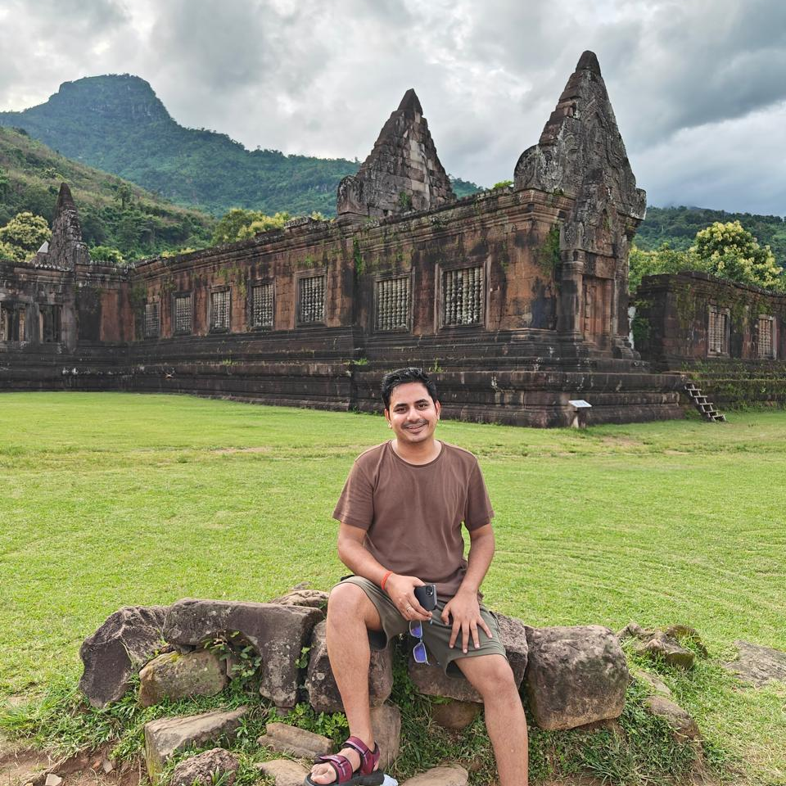
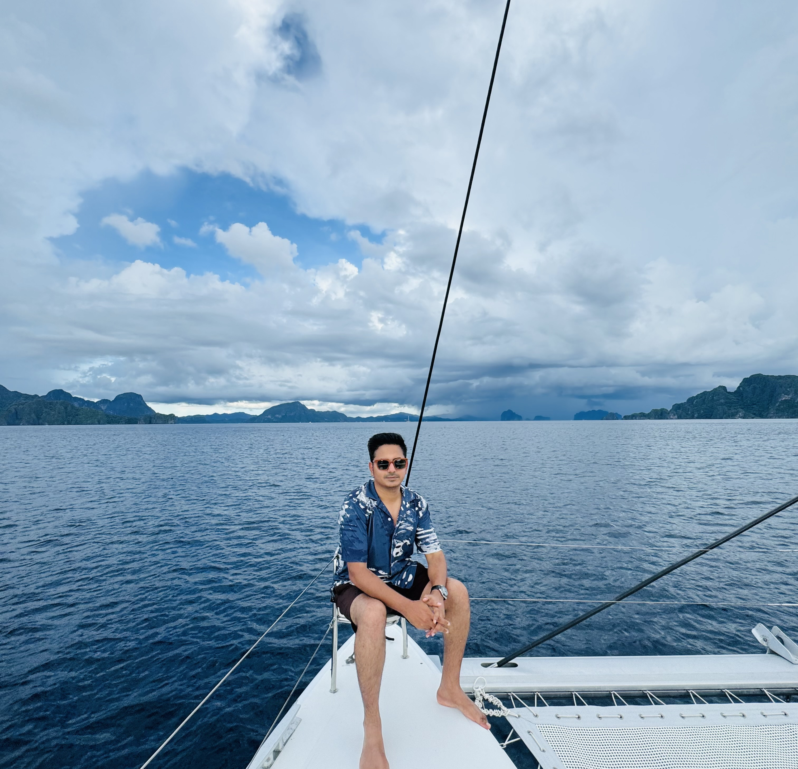
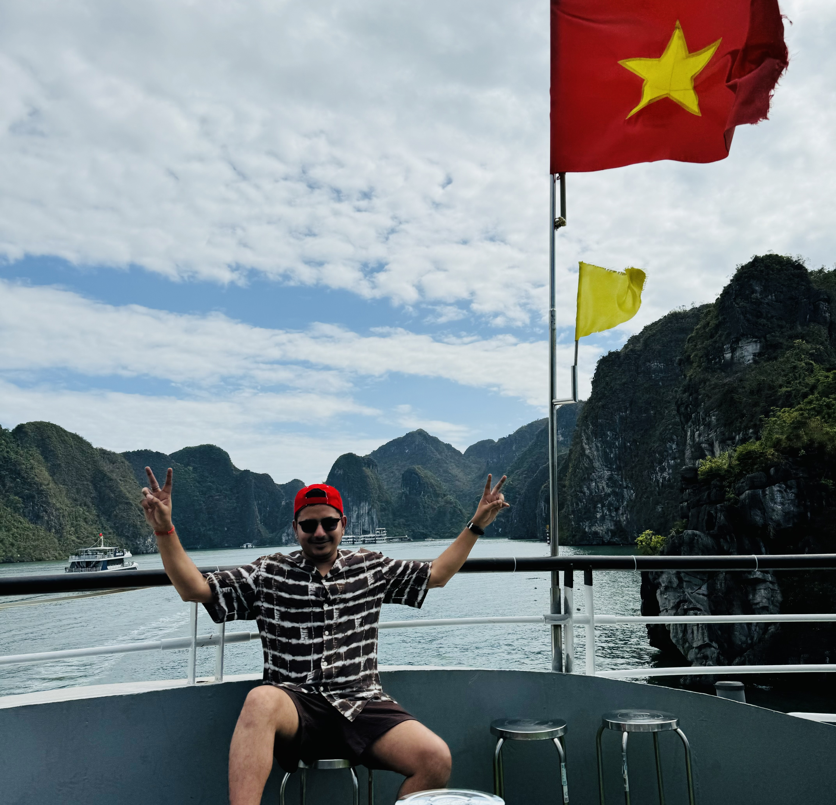
Getting to Know Me
Work
Personal
My role
Branch Controller- Cocoa & Cashew
Significant others / family members / furry friends in my life
I have my mom & dad in my family
Tenure in ofi/Olam
3 years
How I enjoy spending my free time
Scrolling Reddit
Previous companies I have worked at
Adani Wilmar
My favorite / comfort food
Muesli with milk
Why I joined ofi/Olam and what keeps me here?
For the global exposure and everyday brings new challenges and chances to grow
My favorite song
Die with a smile
Pankaj Mishra
‘Panks’
A few fun facts about me
I can sleep anytime
This is me outside work, doing stuff I enjoy in my life …

